Slide 1
Deriving Climate Change Signal from Hyperspectral Sounders Using Spectral Fingerprinting Method
Xu Liu
NASA Langley Research Center, Hampton, VA, USA
Xu.Liu-1@nasa.gov
Acknowledgements
W. Wu, Q. Yang, A. X. Xiong, Larar, D. Zhou, NASA Sounder SIPS, NOAA NUCAPS Team, NASA NAS and NCCS, NASA DACC, NASA Science of Terra, Aqua, and Suomi NPP Program

Slide 2
Deriving Climate Signal from Hyperspectral IR Sounders
Issues with traditional L1-L2-L3 climate products
  L2 algorithm inconsistency for different satellite sensors
  Lack of radiance closure (e.g cloud-clearing method)
  L1-L2-L3 algorithm is computational demanding
PCRTM-based Spectral Fingerprinting method
  Works on gridded L1 products directly using consistent radiative kernels
  All parameters including clouds retrieved simultaneously
  More than 5 orders of magnitude faster than traditional L1-L2-L3 method
  Quick re-generation of products when instrument is re-calibrated or L1 algorithm is improved
Provide radiative kernels needed for climate studies
  Climate model validations using satellite data
  Climate model improvements
Both PCRTM SFOV and spectral fingerprinting algorithms are being transition to NASA SIPS and GES DISC for generating weather and climate products

Slide 3
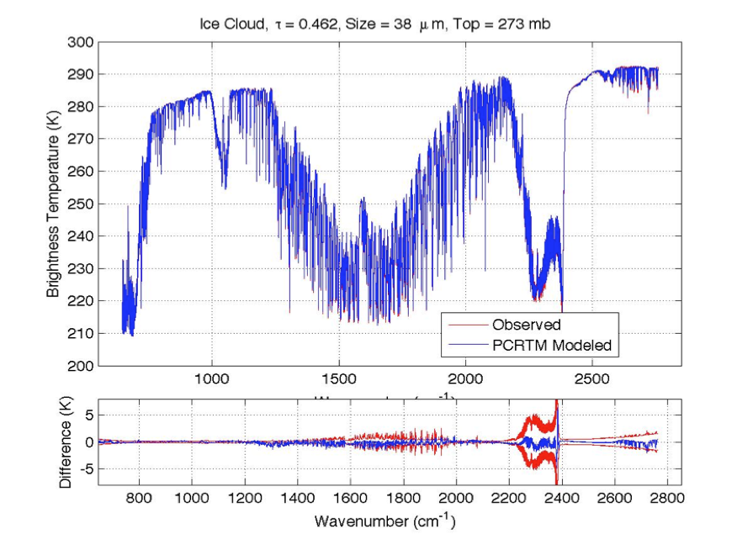
PCRTM Forward Model is Accurate and Fast
IASI
CrIS
AIRS
Sensor | Channel Number | PC score (seconds) | PC score + radiance | PC score + PC Jacobian
CLARREO, 0.1 cm⁻¹ | 19901 | 0.014 s | 0.022 s | 0.052 s
CLARREO, 0.5 cm⁻¹ | 5421 | 0.011 s | 0.013 s | 0.039 s
CLARREO, 1.0 cm⁻¹ | 2711 | 0.0096 s | 0.012 s | 0.036 s
IASI, 0.25 cm⁻¹ | 8461 | 0.011 s | 0.012 s | 0.044 s
AIRS, 0.5-2.5 cm⁻¹ | 2378 | 0.0060 s | 0.0074 s | 0.031 s
CrIS,0.625-2.5 cm⁻¹ | 1317 | 0.0050 s | 0.0060 s | 0.021 s
NAST-I, 0.25 cm⁻¹ | 8632 | 0.010 s | 0.013 s | 0.045 s
S-HIS, 0.5 cm⁻¹ | 4316 | 0.008 s | 0.008 s | 0.038 s
CrIS, 0.625 cm⁻¹ | 2211 | 0.009 s | 0.009 s | 0.033 s
Consistent model for all sounders
Multiple scattering clouds included
15 variable trace gases
Output analytical Jacobians
Very accurate relative to Line-by-Line RT
  Bias error < 0.002 K
  RMS error < 0.03K
4 orders of magnitude faster than LBLRTM

Slide 4
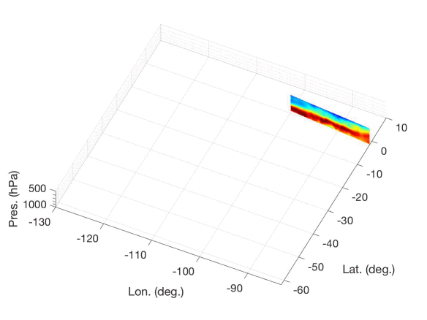
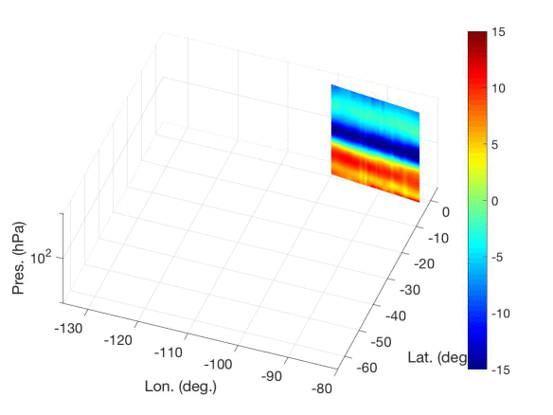
PCRTM Retrieval Algorithm can capture detailed 3-D atmospheric temperature and humidity features
Retrieved Atmospheric Relative Humidity from combined CrIS/ATMS(12/21/2015) PCRTM algorithm
Retrieved Atmospheric Temperature from combined CrIS/ATMS PCRTM algorithm

Slide 5
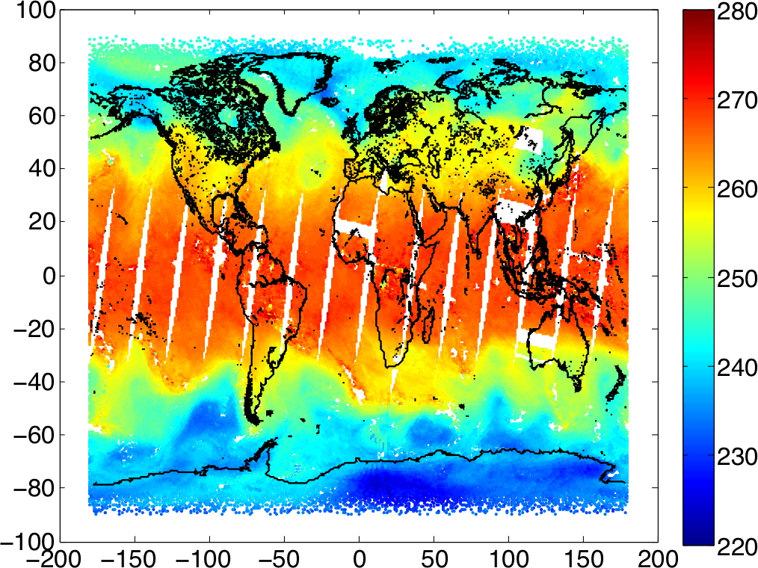
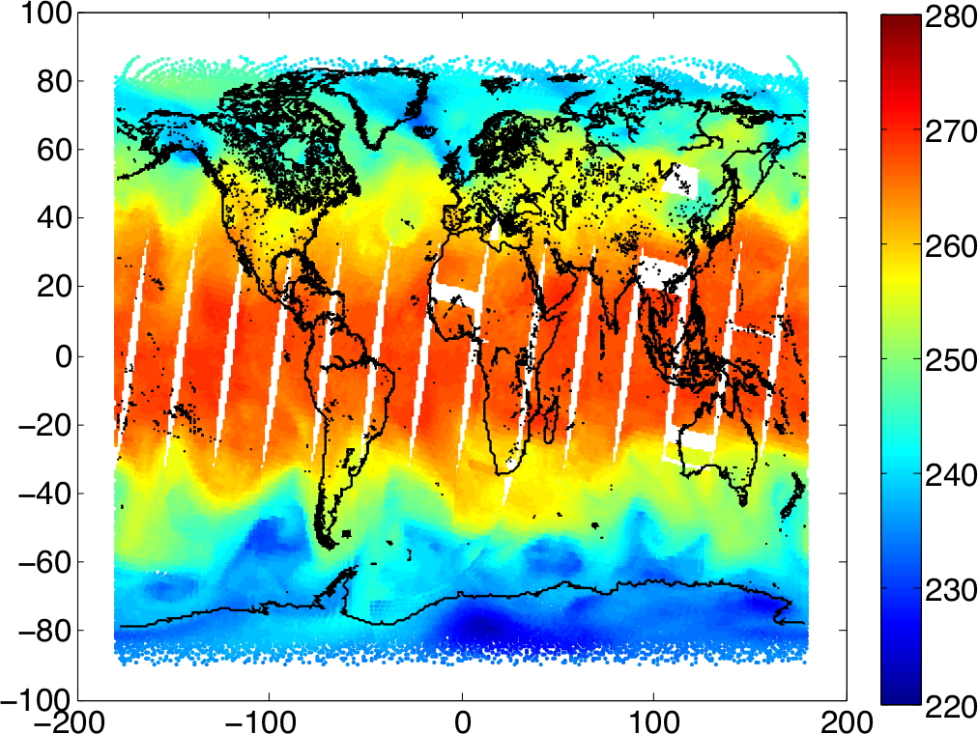
Examples of PCRTM-RA Retrieved and ECMWF Atmospheric Temperature and Water Vapor from CrIS
PCRTM-RA Retrieved Temperature at 500 hPa
PCRTM-RA Retrieved H₂O at 500 hPa
500 hPa Temperature from ECMWF
H₂O at 500 hPa from ECMWF

Slide 6
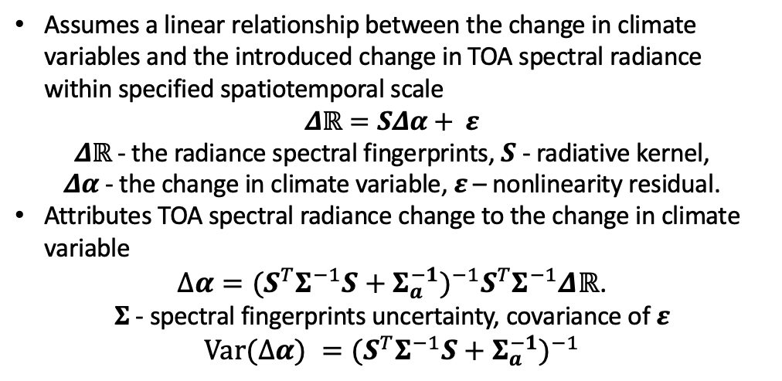
Spectral fingerprinting methodology
Assumes a linear relationship between the change in climate variables and the introduced change in TOA spectral radiance within specified spatiotemporal scale
$Δℝ=SΔα+ ε$
𝜟$ℝ$- the radiance spectral fingerprints, 𝑺 - radiative kernel,
𝜟𝜶 - the change in climate variable,$ε$ – nonlinearity residual.
Attributes TOA spectral radiance change to the change in climate variable
$∆α={{{{{(S}^{T}Σ}^{−1}S+Σ_{a}^{−1})}^{−1}S}^{T}Σ}^{−1}\text{Δ}ℝ$.
𝚺 - spectral fingerprints uncertainty, covariance of $ε$
$$Var(∆α) {={{(S}^{T}Σ}^{−1}S+Σ_{a}^{−1})}^{−1}$$
Spectral fingerprinting challenges
Requires complicated radiative kernels 𝑺 to account for contributions from major climate variables including temperature, water vapor, surface properties, trace gases, and clouds
Need to ensure the ‘radiance closure’

Slide 7






Jacobian calculated using PCRTM under all-sky conditions
O$ptical depth @550nm: τ$=3.95, $τ$=2.21, $τ$=1.36, clear sky
$$dR/dT$$
$$dR/dTskn$$
$$dR/dH2O$$
$dR/dO$₃
$dR/dCO$₂
$$dR/dCO$$

Slide 8
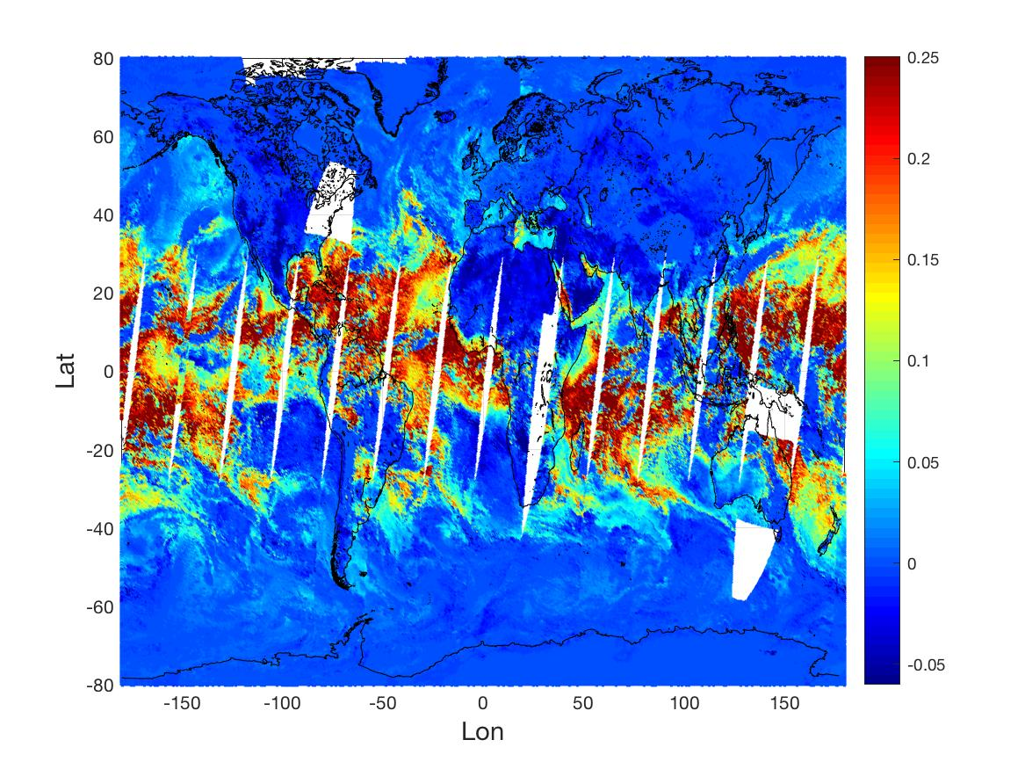
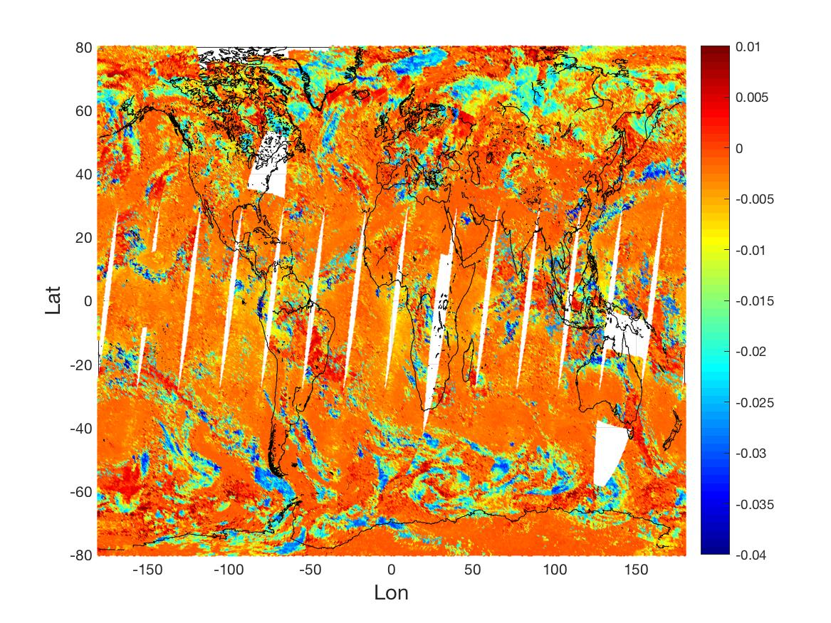
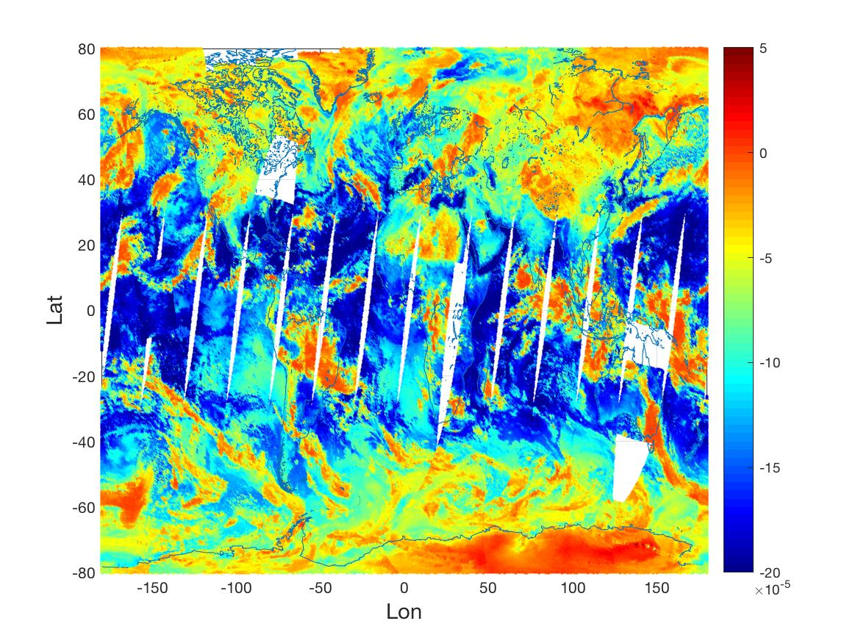
Global distribution of the Radiative Kernel
Example PCRTM retrieved radiative kernel for CrIS at different altitudes
Retrieved parameters include
  T, H₂O, CO₂, CO, CH₄, N₂O, O₃, cloud phase/temperature/optical depth/size, surface skin temperature and surface emissivity
dR/dH₂O
dR/dT
dPC/dCO₂

Slide 9
Comparison of SFOV PCRTM-RA Results and Spectral Fingerprinting Results for CrIS
Monthly mean tropical ocean Temp. anomalies
from CrIS Descending Observations

Slide 10
PCRTM Spectral Fingerprinting Results on Overlanpping AIRS and CrIS Data
Comparison between the temperature anomalies at different altitudes derived from the monthly mean AIRS spectral anomalies observed over tropical ocean regions from January 2013 to December 2018 and the corresponding values from the CrIS monthly mean spectral anomalies.

Slide 11
9.5 hPa monthly mean tropical ocean temperature anomalies from AIRS Descending Observations
Comparison of AIRS L3 Product with PCRTM Spectral Fingerprinting for Long-term AIRS Data

Slide 12
Temperature anomalies derived from SFOV retrieval and from spectral fingerprinting
Single FOV PCRTM retrieval algorithm and spectral fingerprinting method have been applied to CrIS/ATMS data
  Processed tropical region for 2016-2017 and part of 2014
  Monthly mean temperature anomalies of 2016 derived from the zonal averaged spectral fingerprints of CrIS observations over the tropical ocean region
Spectral fingerprinting results
Physical retrieval results
Differences

Slide 13

Summary and conclusions
Spectral fingerprinting using PCRTM is a great tool for climate change studies
  Works on gridded average radiances
  The spectral fingerprinting is very fast—very important for updating the climate record when satellite Level 1 product is reprocessed
  PCRTM SFOV retrieval algorithm produces realistic radiative kernels
Both PCRTM SFOV retrieval and spectral fingerprinting algorithms are being transitional to NASA Data Center
  Will produce two decades of high-quality climate data record with consistent methodology
  Will produce high-spatial resolution L2 data for each hyperspectral FOV

